Slide 1
DIVING BEHAVIOR AND PHYSIOLOGY OF LEATHERBACK TURTLE
GROUP 31

Slide 2
OUTLINE
Overview of leatherback turtle
Diving behavior of leatherback turtle
Physiology of the diving behavior
Importance of studying diving behavior

Slide 3
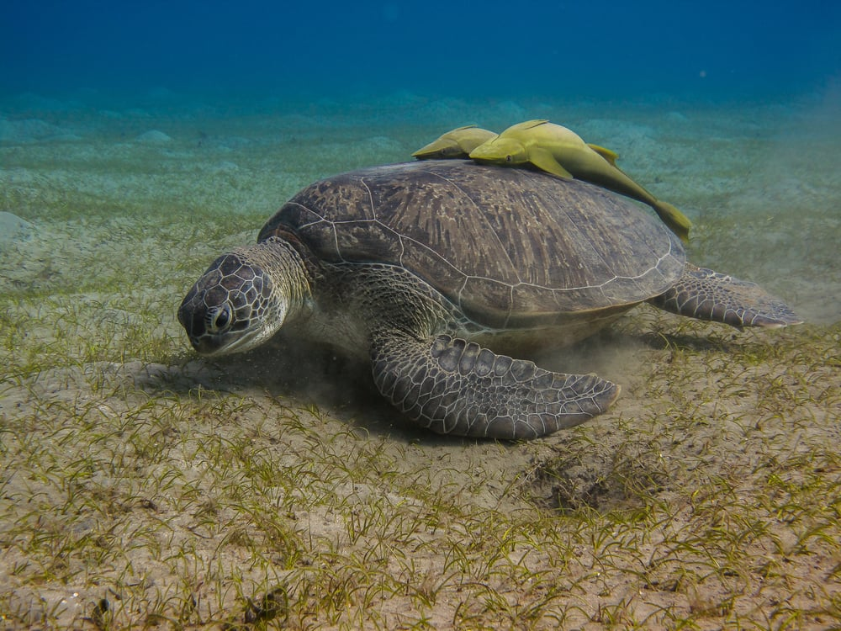
OVERVIEW OF LEATHERBACK TURTLE
Leatherback sea turtle (Dermochelys coriacea) is the largest of all sea turtles.
They make long-distance oceanic migrations across the globe.
Female leatherbacks come to the shore to lay eggs.
Fig.1 Leatherback turtle

Slide 4
DIVING BEHAVIOR OF LEATHERBACK SEA TURTLES
Leatherbacks spend most of their time in the top 300 m of the water column in dives less than 20-30 minutes ( Nathan et al., 2015).
They can also dive to depths of about 1 km and remain submerged for about 90 minutes between breaths (Nathan et al. 2015).

Slide 5
DIVING BEHAVIOR OF LEATHERBACK SEA TURTLES
Why do they dive?
To avoid predators
Search for prey
Avoid heat in the tropics

Slide 6
PHYSIOLOGY OF DIVING BEHAVIOR OF LEATHERBACK TURTLES
Aerobic metabolism
Increased lung tidal volume to facilitate rapid C02 unloading and O2 uptake at the surface.(Amanda et al., 1999).

Slide 7
PHYSIOLOGY OF DIVING BEHAVIOR OF LEATHERBACK TURTLES
Variation in heart rate
Brachycardia (averagely 13 beats per minute) facilitates survival during diving.
Tachycardia (averagely 30 beats per minute) aids restoration of blood flow to tissues and flushing of metabolites that might have built up during diving allowing for efficient uptake of oxygen during resurfacing (Amanda et al., 1999).

Slide 8
PHYSIOLOGY OF DIVING BEHAVIOR OF LEATHERBACK TURTLES
Thermoregulation through resurfacing
High pressure tolerance
Structural adaptations to aid physiological processes.

Slide 9
IMPORTANCE OF STUDYING DIVING BEHAVIORS
CONTINUATION
It provides crucial insights into ecological roles of marine animals and their interactions within marine ecosystems
It contributes to our knowledge of marine physiology and animal health

Slide 10
CONCLUSION
The physiology of the diving behavior in leatherback sea turtles provides accurate insight into the various mechanisms that facilitate diving in marine organisms. Marine ecologists can harness this knowledge to improve upon the construction of various equipments for diving expeditions.

Slide 11
REFERENCES
Ayaka Asada, Scott A. Eckert, Frances P. Gelwick, William H. Hagey, Randall W. Davis,Diving behavior and energetic strategy of leatherback sea turtles during internesting intervals on St. Croix, U.S. Virgin Islands, Journal of Experimental Marine Biology and Ecology, Volume 550,2022.
Paladino FV, O'Connor MP, Spotila JR (1990). "Metabolism of Leatherback Turtles, Gigantothermy, and Thermoregulation of Dinosaurs". Nature. 344 (6269): 858–860.
Penick DN, Spotila JR, O'Connor MP, Steyermark AC, George RH, Salice CJ, Paladino FV (1998). "Thermal Independence of Muscle Tissue Metabolism in the Leatherback Turtle, Dermochelys coriacea". Comparative Biochemistry and Physiology A. 120 (3): 399–403.
Bjorndal, K.A. et al., 1997. Foraging Ecology and Nutrition of Sea Turtles. In The Biology of Sea Turtles by Peter L. Lutz and John A. Musick. 218-220.

Slide 12
REFERENCES
Nathan J. Robinson, Frank V Paladino (2015). Diving behavior and physiology of the leatherback sea turtle. The leatherback sea turtle, 21-31.
Amanda L. Southwood et al. (1999). Heart rates and diving behavior of leatherback sea turtles in the Eastern Pacific Ocean. The Journal of Experimental biology, 202, 1115-1125.

Slide 13


